Slide 1
WGIC26 · WORLD GREEN INFRASTRUCTURE CONGRESS 2026 · BARCELONA–LLEIDA
Site Report
Nº2
JUL 29 — SEP 7, 2026
Everything that changed on wgic26.barcelona in the second build window: a registration-ready header, validated programme content, the WGIN Awards done properly, ten newsletters rebuilt as sent, and a full consistency pass.
01 Registration-ready header02 Main topics, validated03 WGIN Awards, official
04 Newsletters, as sent05 The consistency pass06 Registrations snapshot
WGIC26 — SITE REPORT · JUL 29 – SEP 7, 2026

Slide 2
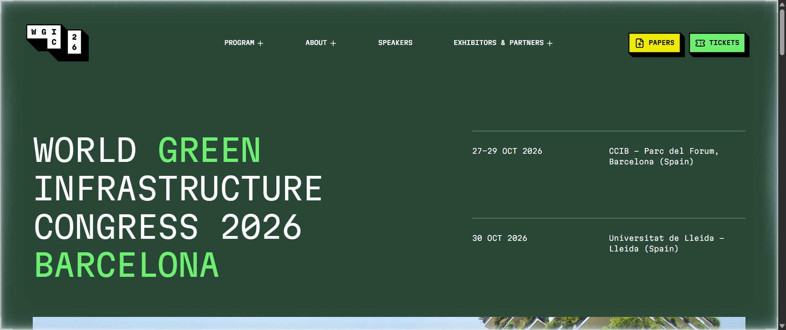
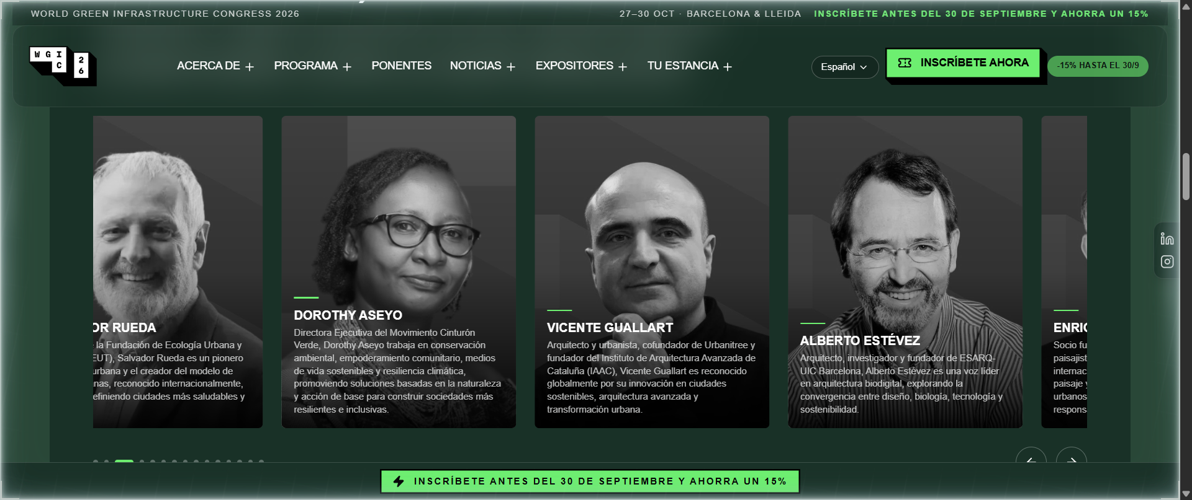
01 — REGISTRATION-READY HEADER · SITE REPORT — JUL 29 – SEP 7, 2026
The front door now asks for the sale — politely, on every page.
−15%
100%
BEFORE — JULY
EARLY-BIRD BADGE IN THE HEADER + TOP AND BOTTOM STRIPS
REGISTER CTAS NOW POINT STRAIGHT TO HÉLICE
i. Fixed header with a green Register now button and a −15% badge, visible on every page and every scroll position.
ii. Early-bird strips, top and bottom: register before 30 September and save 15%.
iii. Every Register CTA — header, footer, newsletters — goes straight to the Hélice platform. No more detours through the site.
iv. Early-bird dates are localized by language: 30/09 in Spanish, 09/30 in English.
AFTER — LIVE NOW
HEADER + REGISTRATION FUNNEL
WGIC26 — SITE REPORT · SEP 2026

Slide 3
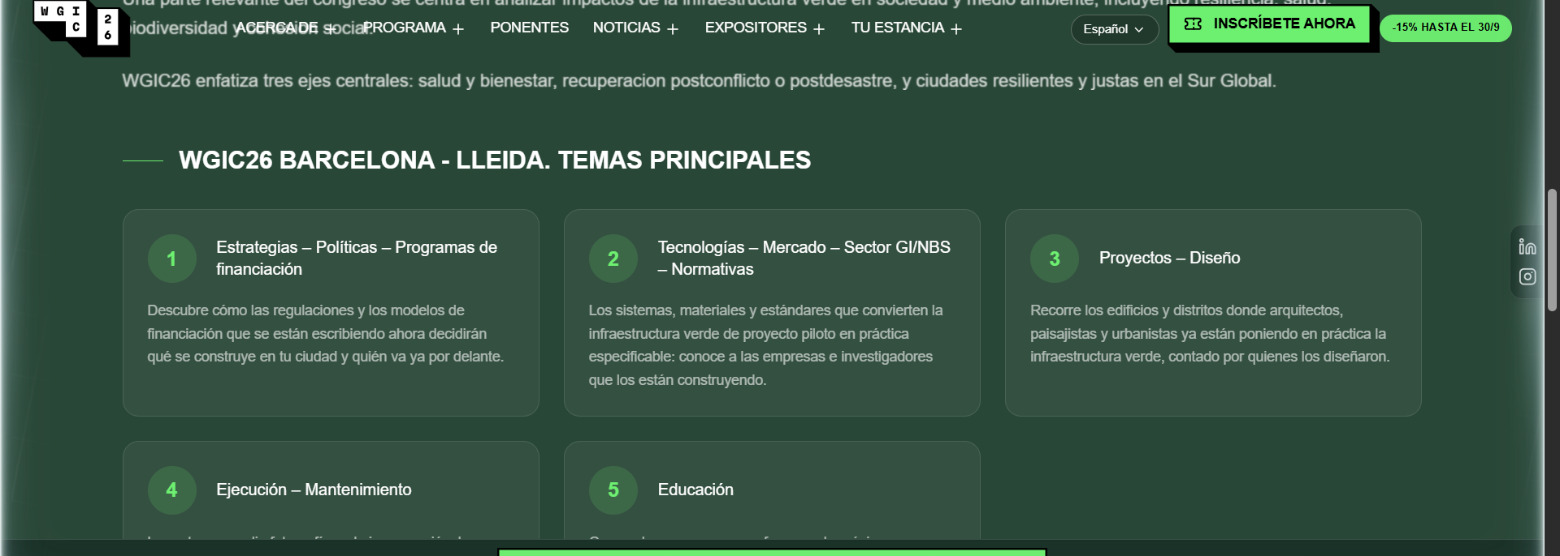
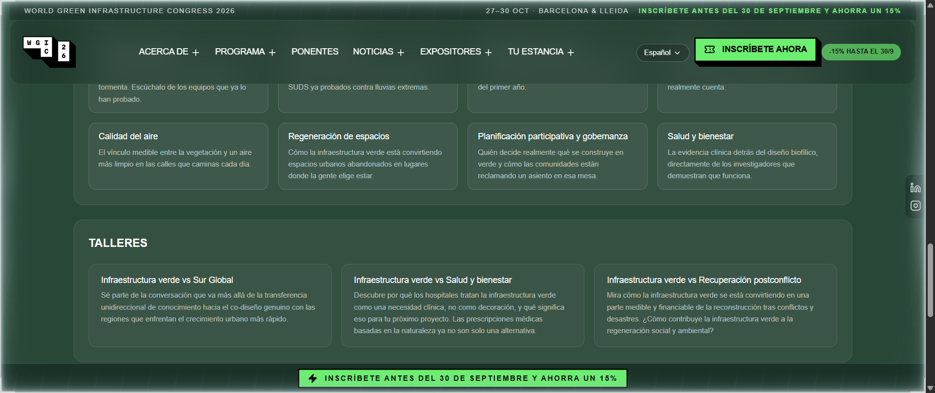
02 — MAIN TOPICS, VALIDATED · SITE REPORT — JUL 29 – SEP 7, 2026
The programme's spine, rewritten with the committee and rebuilt as numbered cards.
6+8+3
NUMBERED TOPIC CARDS
MAIN TOPICS · IMPACT AREAS · WORKSHOPS
COPY SET VALIDATED BY THE COMMITTEE BEFORE GOING LIVE
i. The old accordion list is out. Each topic is now a numbered card with its own one-line pitch.
ii. The full validated set is live: 6 main topics, 8 impact areas and 3 workshops, with the committee's descriptions.
iii. A workshops preview — Global South, Health & Well-being, Post-Conflict Recovery — sits on the same page, so the schedule story reads top to bottom.
IMPACT AREAS + WORKSHOPS PREVIEW
/PROGRAM/TOPICS
WGIC26 — SITE REPORT · SEP 2026

Slide 4
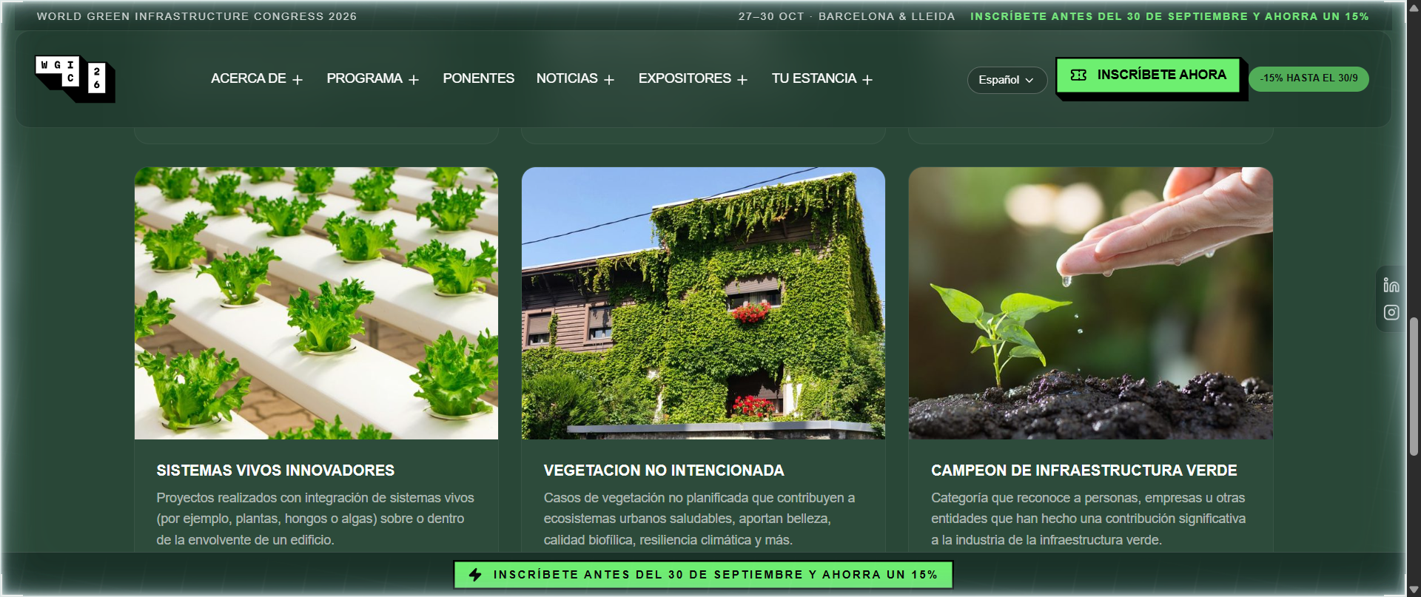
03 — WGIN AWARDS, OFFICIAL · SITE REPORT — JUL 29 – SEP 7, 2026
Expired modules out. The nine official categories in — with WGIN's own words and photos.
9
0
CATEGORY CARDS, LIVE
OFFICIAL AWARD CATEGORIES, EACH WITH DESCRIPTION AND PHOTO
EXPIRED MODULES LEFT ON THE PAGE
i. Removed the expired modules — past deadlines and outdated calls to action that made the awards look closed.
ii. New intro links out to WGIN and announces that the 2026 winners will be recognized across nine key categories.
iii. Every category card carries the official WGIN description and a photo pulled from awards.wgin.org, optimized for fast loading.
The nine categories: Green Roofs · Green Walls · Green Neighbourhood · Green Infrastructure Policy · GI Research: Academic Work · GI Research: Student Posters · Innovative Living Systems · Unintended Greenery · Green Infrastructure Champion
Copy and photography: official WGIN material, used with the committee's sign-off.
/PROGRAM/WGIN-AWARDS
WGIC26 — SITE REPORT · SEP 2026

Slide 5
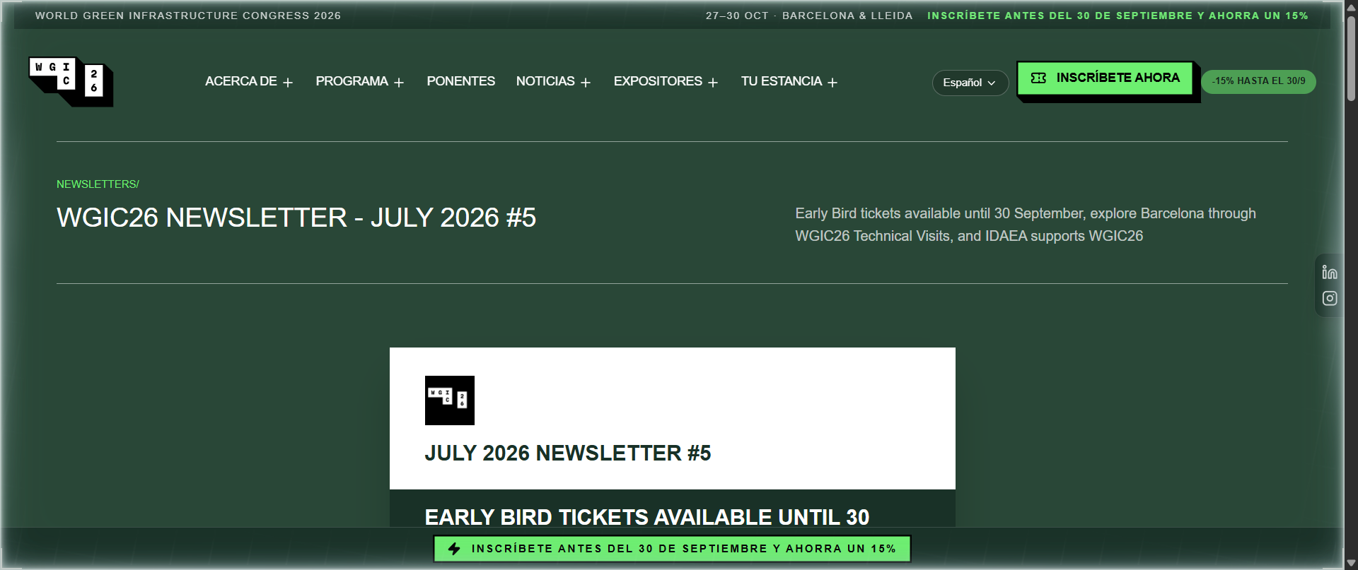
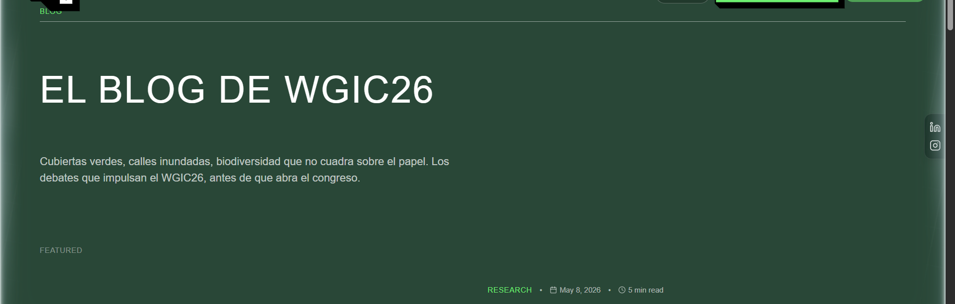
04 — NEWSLETTERS, AS SENT · SITE REPORT — JUL 29 – SEP 7, 2026
Ten campaigns rebuilt as the emails people actually received — logos and all.
10 → 56
100%
NEWSLETTER
CAMPAIGNS REBUILT → LOCALIZED PAGES LIVE
IN-EMAIL REGISTER LINKS NOW POINT TO HÉLICE
i. Newsletters 1–10 rebuilt in real email format — header block, sections and footer as sent — across ±56 localized pages.
ii. The broken logo rendering is fixed: the WGIC26 mark now shows in every issue.
iii. Registration CTAs inside the newsletters go to Hélice, not back to the site.
iv. A Register now link was added to the site footer, site-wide.
BLOG, RELAUNCHED
/NEWSLETTERS + /BLOG
WGIC26 — SITE REPORT · SEP 2026

Slide 6
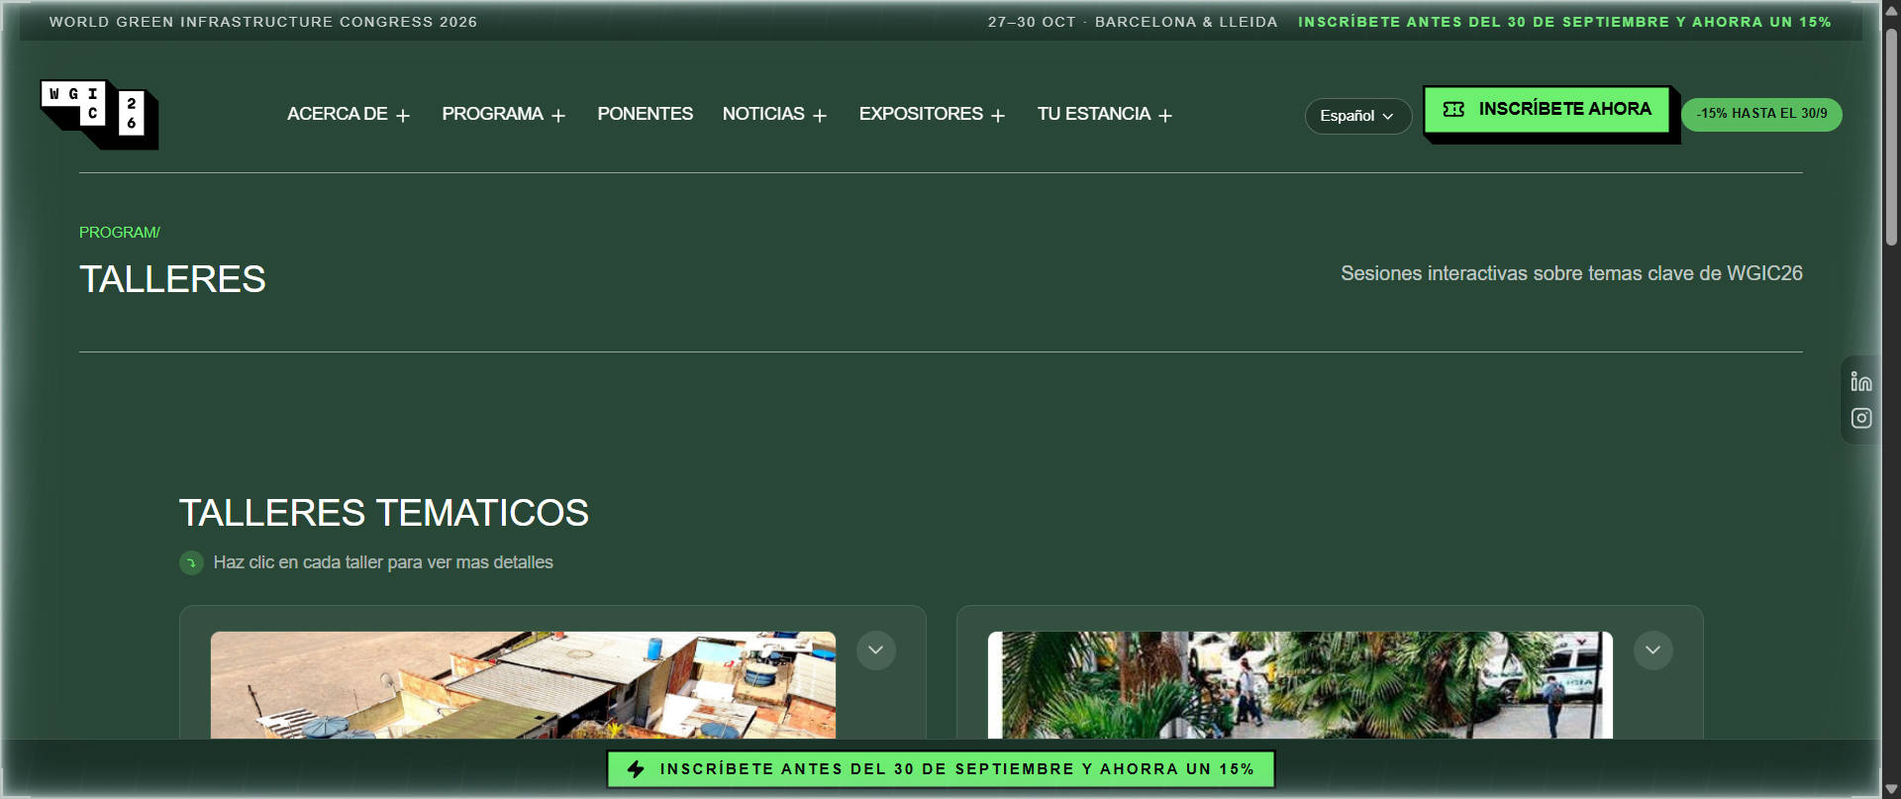
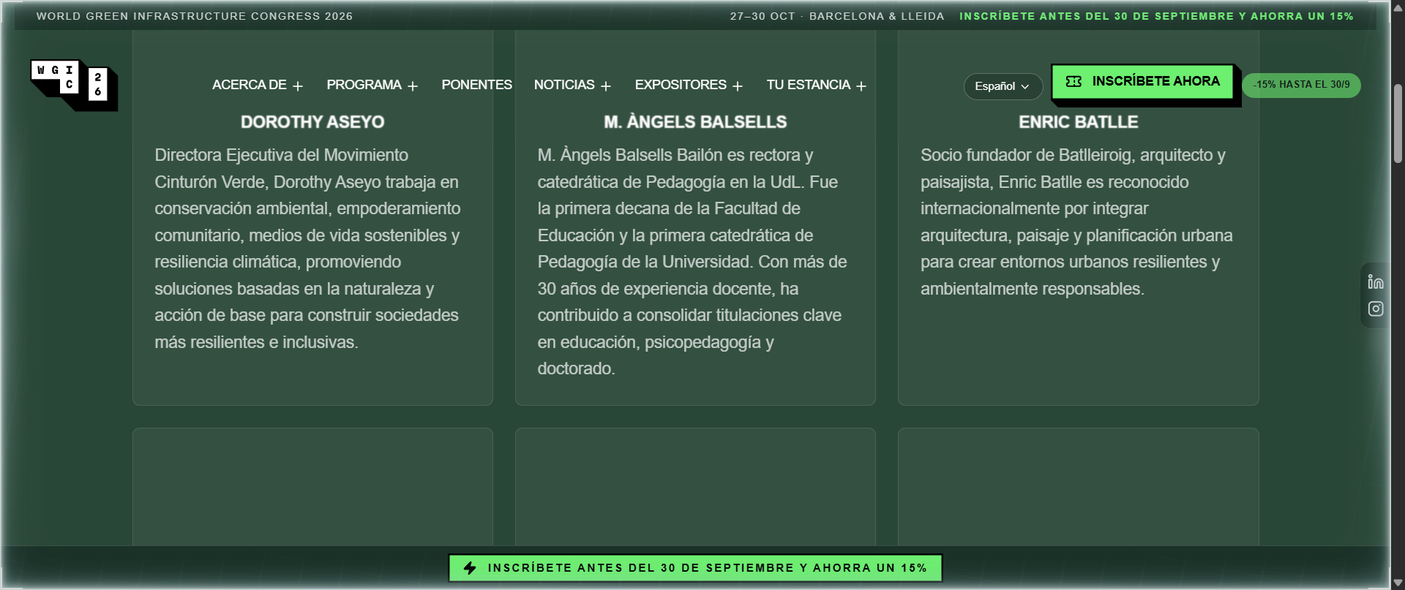
05 — THE CONSISTENCY PASS · SITE REPORT — JUL 29 – SEP 7, 2026
Thirty-five tracked fixes that make the whole site read like one voice.
35
6
WORKSHOPS, REBALANCED 2+2
TRACKED FIXES SHIPPED IN THIS WINDOW
LANGUAGES — FR/PT MENUS NO LONGER OVERFLOW THE SCREEN
i. Programme → Program everywhere; CTAs unified in green; justified text removed.
ii. French and Portuguese menus now fit the viewport; mistranslations fixed.
iii. Workshops grid rebalanced 2+2, one horizontal photo per workshop; extra CTAs removed from Technical Visits and Innovation Day.
iv. Plan your stay: hotel module out, Catalan cultural-tourism campaign in.
v. Keynote speakers: alphabetical order, moved ahead of News, larger bios.
KEYNOTES, ALPHABETICAL + FULLER BIOS
SITE-WIDE CLEAN-UP
WGIC26 — SITE REPORT · SEP 2026

